Slide 1
Chemistry: I, II and II
Chapter 8: The Atom
Chapter 10: Chemical Reactions
Chapter 12: Nucleus of the Atom

Slide 2
Chapter 8-Some Main Ideas
Concept of Atom (Democritus, 530 BC)
Modern Chemical Theory-Elements (John Dalton, 1766-1844)
Periodic Table of the Elements (Dmitri Mendeleev, 1869)
Periodic Chemical Properties
Structure of the Atom (Ernest Rutherford, 1911)
Bohr and problems with Rutherford Atom
Electron energy levels (Quanta; Ground State versus Excited States)
Quantum leaps (Photons and Excitation and De-Excitation)
Spectroscopy
Lasers and some of their applications
The Periodic Table and Electron shells

Slide 3
Atoms
Democritus a Greek philosopher considered what would happen if matter were cut up using a very sharp knife. Eventually one would reach a point where matter could no longer be subdivided.
These particles were named “atom” (uncuttable).

Slide 4
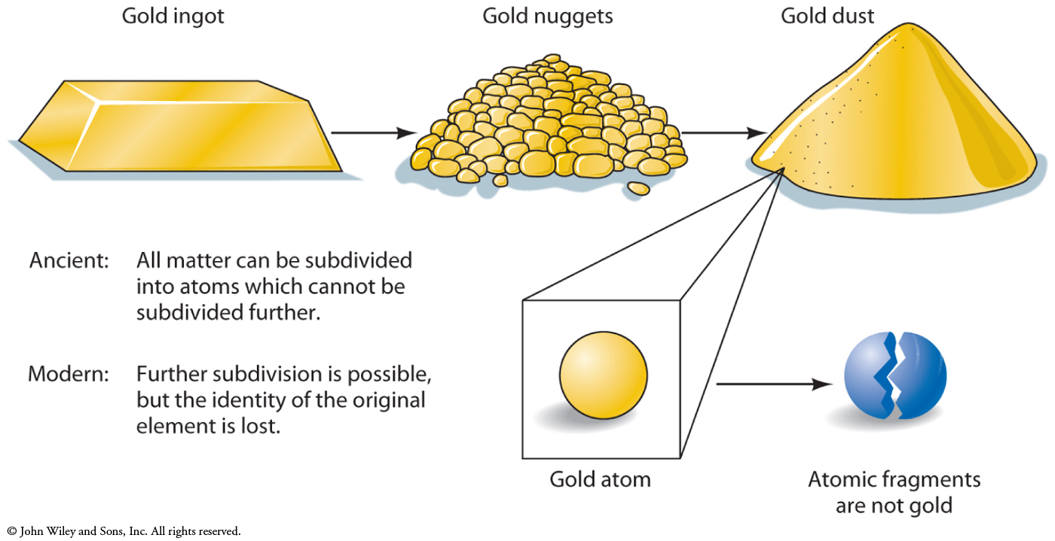
Democritus’ Experiment on Gold

Slide 5
Modern Atomic Theory
John Dalton (1766-1844), an English meterologist published a book entitled “New System of Chemical Philosophy” which described modern atomic theory:
Matter is composed of atoms; they are the fundamental building blocks
Materials which cannot be broken down further are called “elements” (Atomism)
Water can be broken down in hydrogen and oxygen gas using an electrical current (electrolysis)
Two or more atoms together form a molecule
In 1800, fewer than 30 elements isolated
After Volta’s invention of the battery electrolysis was used to isolate more elements (24 between 1800-1850)

Slide 6
Modern Atomic Theory: elements in everyday life
Most materials are compounds made of two or more elements
There are a few pure chemical elements we encounter:
Helium
Carbon
Aluminum
Copper
Gold
Six elements make up 99% of the earth’s solid mass:
Oxygen
Magnesium
Iron
Silicon
Aluminum
Calcium
Most common atoms in the body include:
Carbon
Hydrogen
Oxygen
Nitrogen

Slide 7
The Periodic Table of the Elements
Dmitri Mendeleev (1834-1907), a Russian Chemistry Professor arranged the 63 known elements in order of increasing atomic weight into a table for a new textbook
This configuration revealed that elements with similar chemical properties appeared at regular (periodic) intervals
For example, the first group (left hand column) included: Lithium, Sodium, Potassium, Rubidium
All react with Chlorine and are soft, silver metals
Mendeleev’s Periodic Table not only grouped existing elements of similar chemical reactivity but it could predict the properties of elements not yet identified

Slide 8
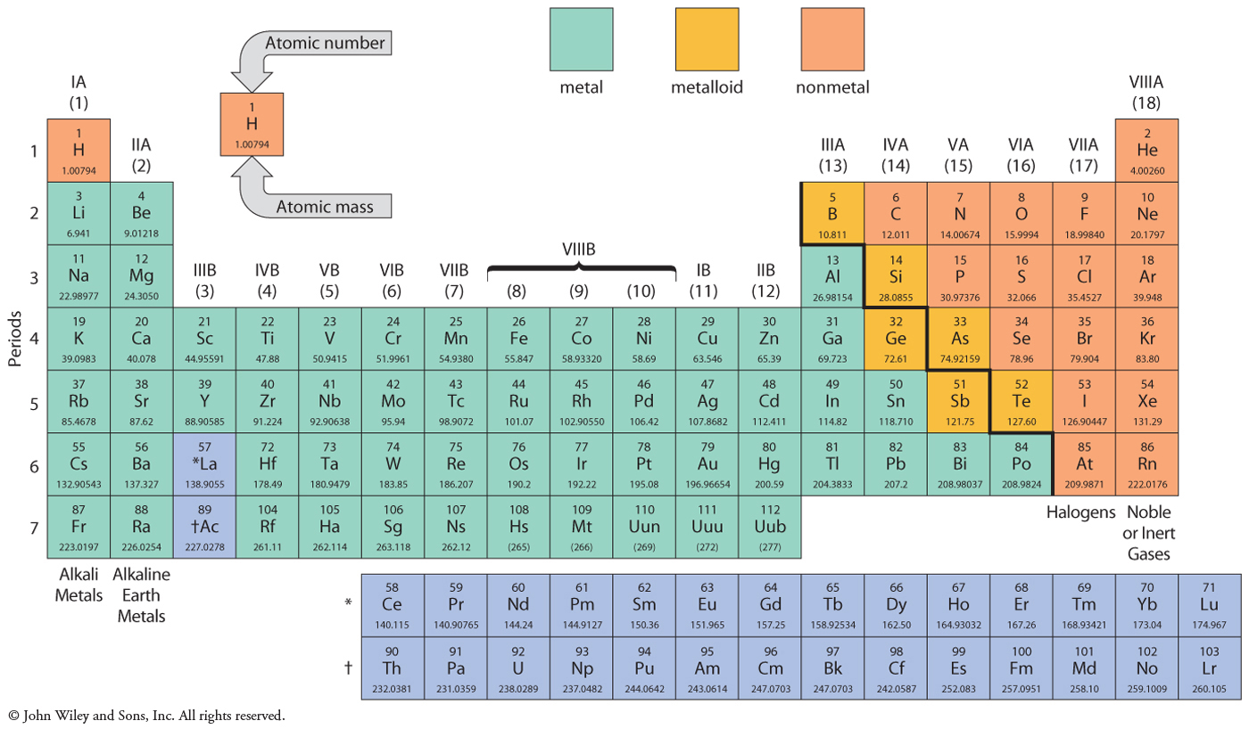
Periodic Table of the Elements

Slide 9
Chemical Properties in Periodic Table
Vertical columns contain elements of similar properties and reactivity
Alkali metals IA (soft silvery metals) form salts with Halogens VIIA
Alkali earth metals IIA are harder and denser than IA, most form oxides in air (with oxygen)
Noble gases (VIIIA) are colourless, odourless and non-reactive

Slide 10
Evidence Supporting the Existence of Atoms
Atoms had not yet been observed
Behaviour of gases (Bernoulli)
Gases possess kinetic energy- their concentration can be increased and the increase in force increases the pressure
Chemical combinations (Dalton)
For any compound, atoms combine in a specific ratio by weight
Radioactivity (Becquerel,Curie)
Individual atoms emit radiation
Brownian motion (Einstein)
Particles in solution move and collide due to forces

Slide 11
More Direct Support for Existence of Atoms
X-ray crystallography (1912)
Atoms in crystal structures cause rays to deflect demonstrating more directly than atoms exist
Atomic Force Microscopy (1980s)
Scanning, tunnelling microscope first actual visualisation of individual atoms

Slide 12
Structure of the Atom
In 1897, Joseph Thomson identified the first subatomic particle: the electron.
The atom itself is made of small fundamental parts (electron, proton, neutron)
General organisation of the atom was demonstrated by Ernest Rutherford (student of Thomson)
A beam of alpha particles was directed a film of gold foil and the resulting pattern was observed. The deflection of only a small number of beams suggested that the atom was composed largely of space.

Slide 13
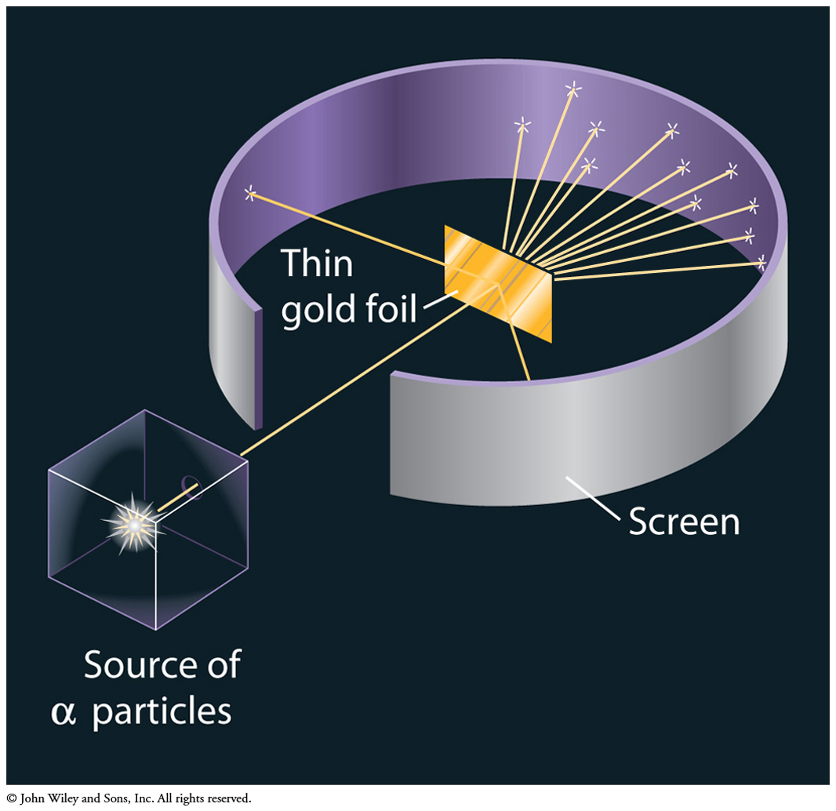
Rutherford’s Gold Foil Experiment

Slide 14
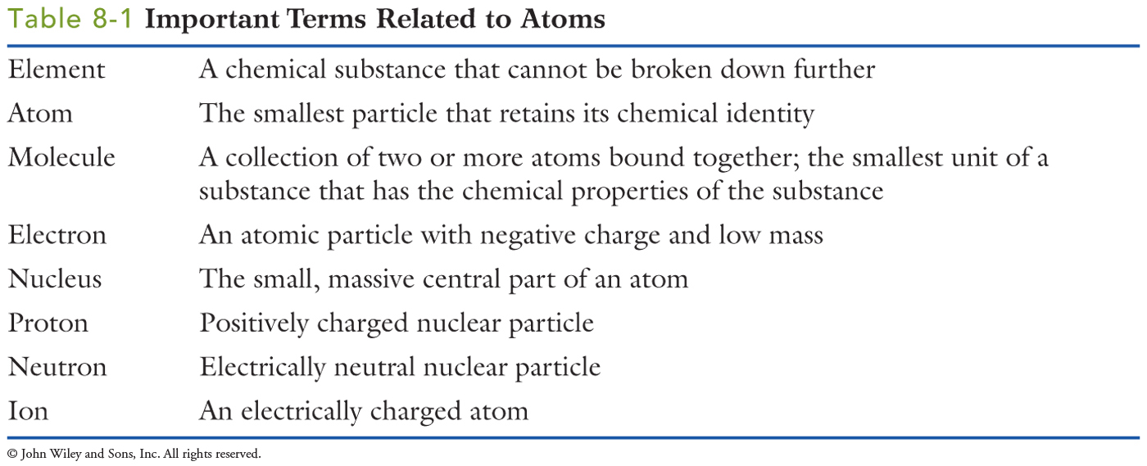
Important Terms in Atomic Theory

Slide 15
Problems with Rutherford Atom
Rutherford was correct in determining that the atom is largely composed of space however other aspects of his model were not tenable:
Objects in circular orbit accelerate and emit electromagnetic radiation
As electrons emit radiation they would spin toward the nucleus and the atom would be unstable (survive less than 1 minute) and eventually destroy itself

Slide 16
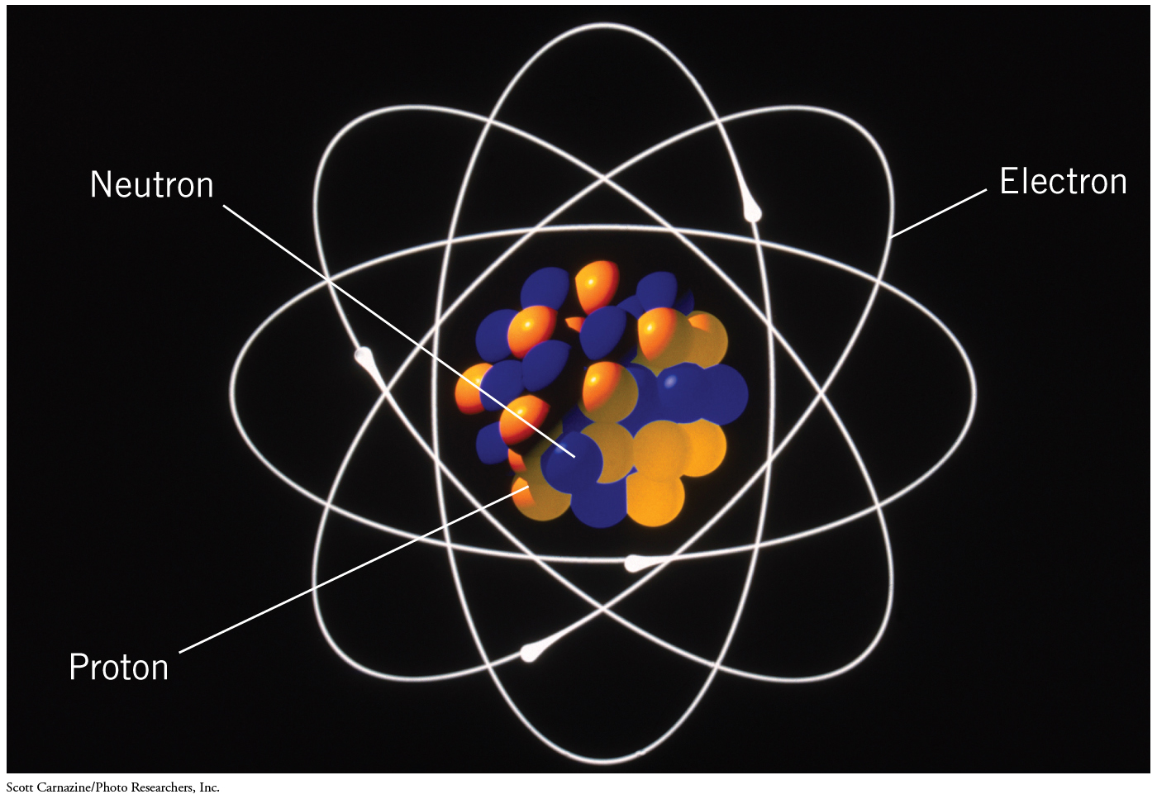
Although appealing due to its similarity with the solar system, the Bohr atom was not a correct model

Slide 17
The Bohr Model of the Atom
Niels Bohr (1885-1962), a Danish physicist proposed an alternative atomic model that avoided the energetic complications of the Rutherford atom
Extending the observation that hot hydrogen atoms give off light of specific wavelengths, Bohr hypothesized that electrons can exist in stable “allowed” orbits (shells) such that they did not give off radiation
These electron shells exist at certain defined distances from the nucleus of the atom (r₁, r₂, r₃ etc) and these correspond to energy levels
Electrons cannot exist in intermediate states between these energy levels

Slide 18
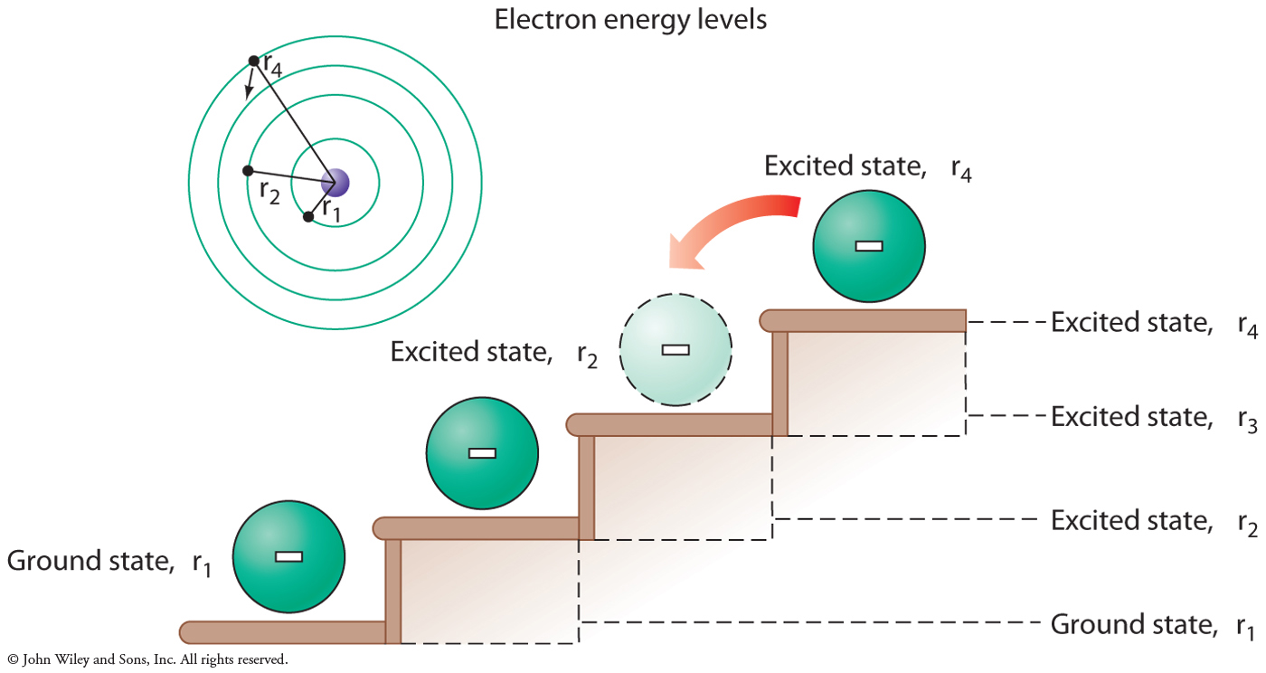
Electron energy levels can be likened to a staircase…

Slide 19
Energy in the Bohr Atom
Movement from one energy level to another involves the absorption or emission of energy
These changes in energy state are discrete steps whereby an intermediate position is never occupied. This is called a quantum leap or jump
Energy is required for the electron to leave the ground state
Energy is emitted in the form of photons when electrons move to lower energy shells

Slide 20
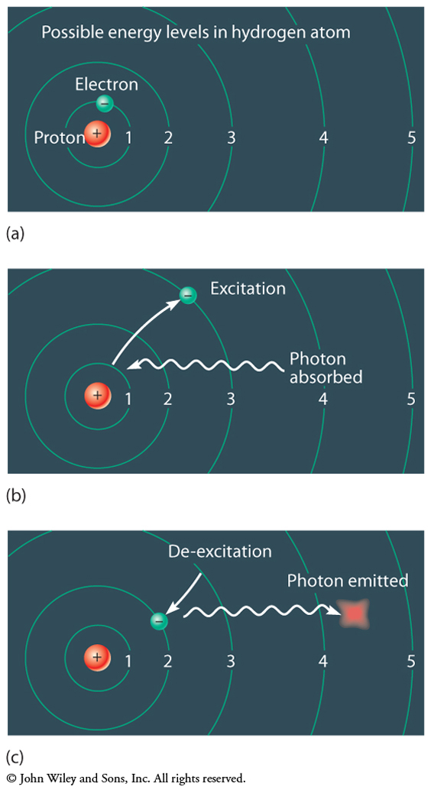
Quantum Leaps in the Bohr Atom: Excitation or De-Excitation

Slide 21
Spectroscopy
Different atoms absorb and emit photons, dependent upon the differences in their energy levels
As a result, each atom has a distinct set of photons
The pattern of all photons emitted by an atom is called its spectrum and may be used to identify different atoms

Slide 22
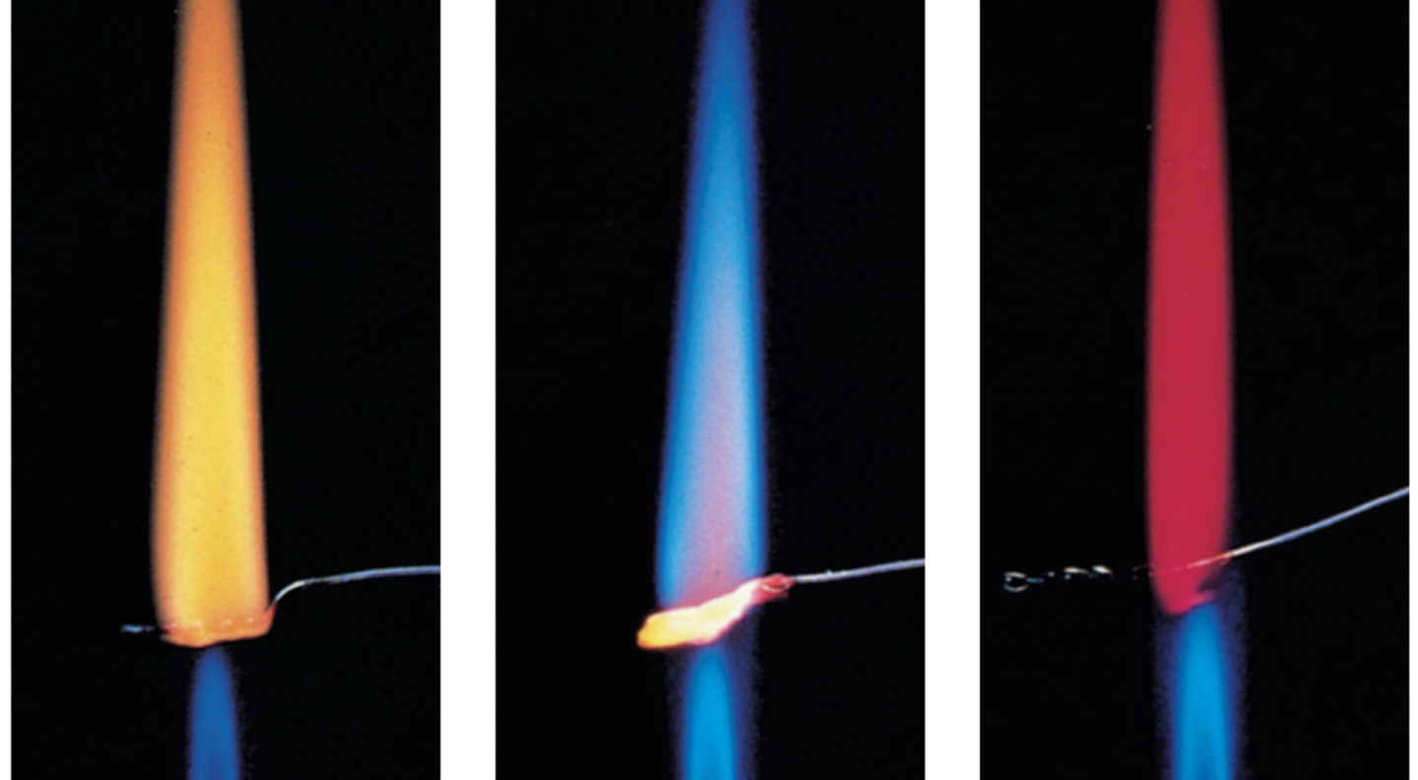
Different Atoms Emit Different Colour of Photons
Sodium
Potassium
Lithium

Slide 23
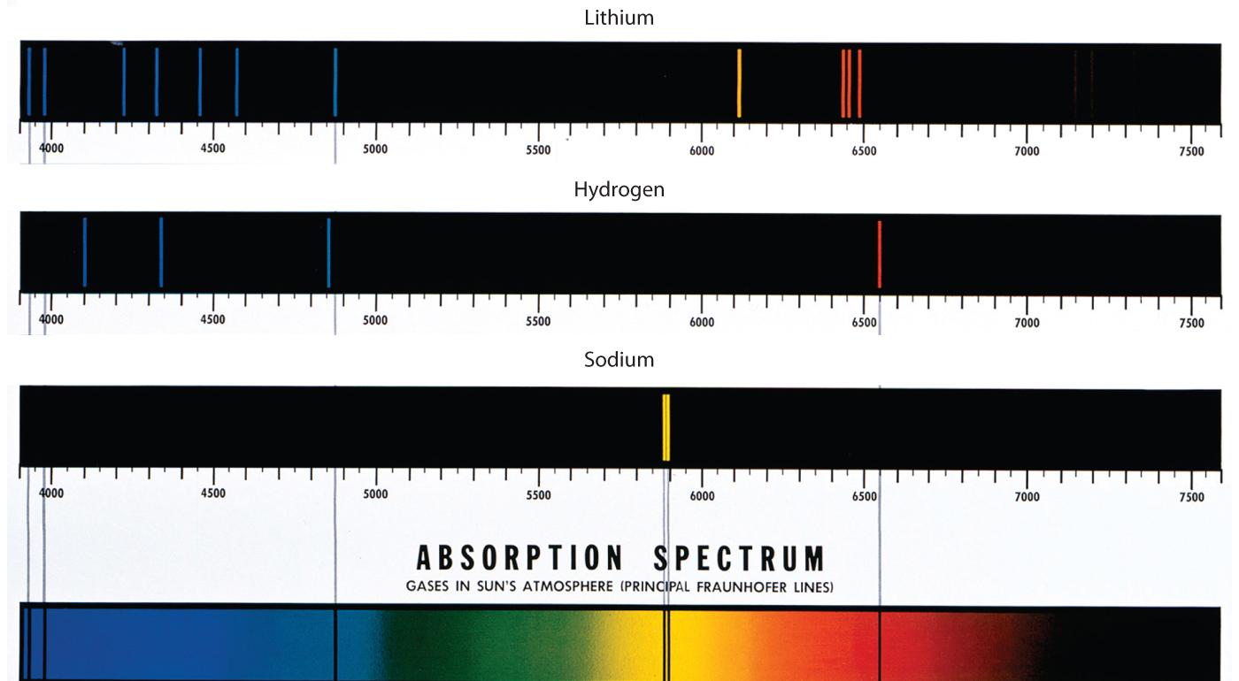
Examples of Spectra

Slide 24
The Bohr Atom at work: Lasers
LASER is an acronym for light amplification by stimulated emission of radiation
All lasers have a source of atoms (crystal or gas) enclosed in a glass tube
Stimulated emission occurs when light interacts with the atoms in the crystal
If a photon passes near an excited electron, the electron may be stimulated to jump to the a lower energy state and release a second photon
The stimulated atoms in a laser emit photons whose electromagnetic radiation waves align (are lined up). This is referred to a coherence or coherent photons
Electrons are “pumped” into an excited state and a beam of photons is released when electrons return to their lowest energy (ground) state
Mirrors are used to reflect the beam back and forth and generate the emission of more photons. These mirrors reflect about 95% back into the laser but the remaining 5% is emitted as a coherent laser beam

Slide 25
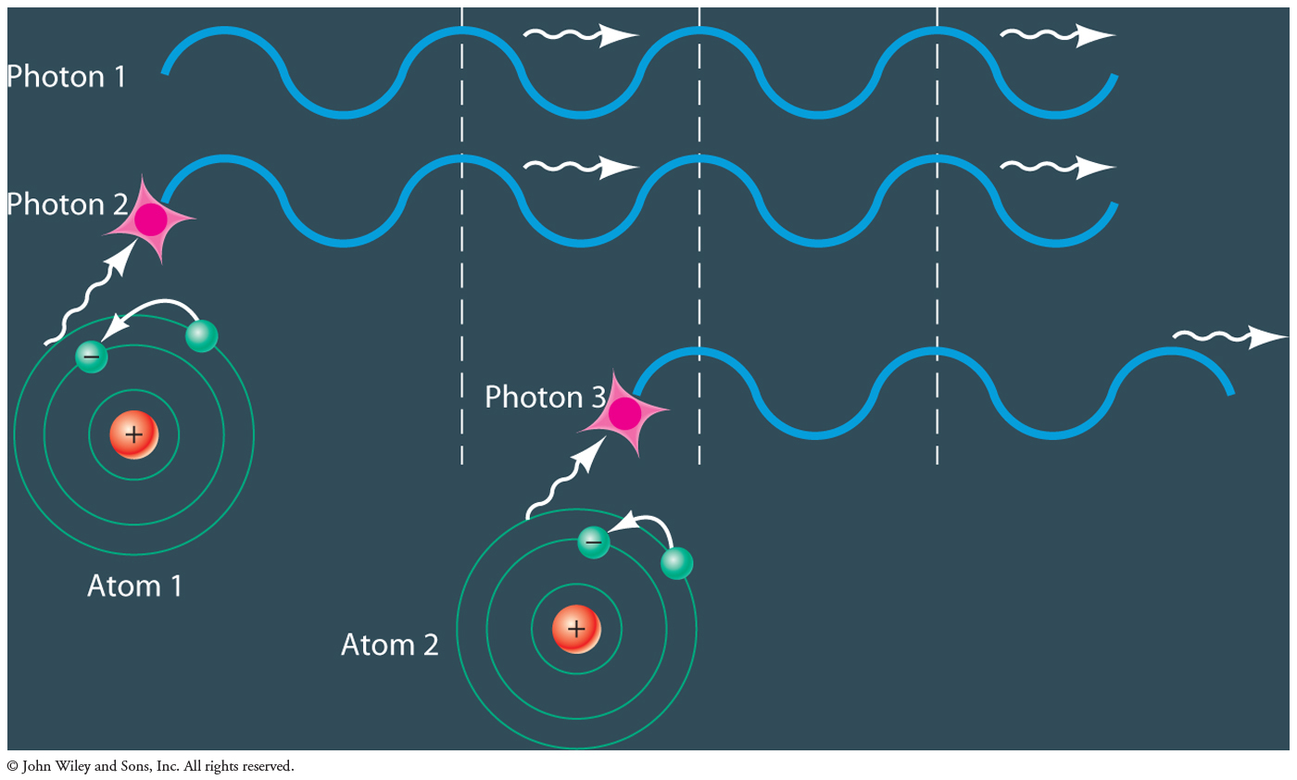
Photon Interactions in a Laser

Slide 26
Applications of Lasers
Lasers are used in scientific equipment such as flow cytometers, plate readers, fluorescent microscopes
Fine surgical techniques (myopia correction, cataract surgery) employs argon lasers
Telescopes are focussed and aligned using lasers

Slide 27
Organisation of the Atom: Electron Shells
The pattern of elements across the periodic table mirrors the arrangement of electrons around the atomic nucleus
The first (or lowest) energy shell accommodates two electrons; the second and third shells each hold 8
While two electrons are in the same shell, the Pauli Exclusion Principle states that they cannot occupy the same energy state at the same time
In the lowest energy shell, the two electrons have opposite “spin” (one clockwise and one counterclockwise)
Electrons fill the shells, starting with the lowest shell

Slide 28
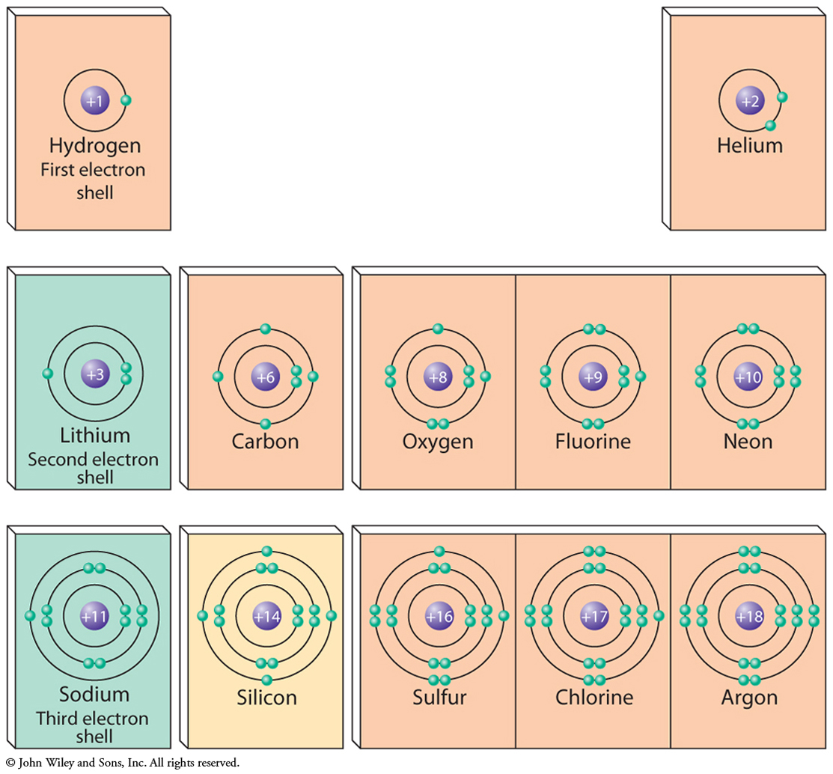
Periodic Table: Organisation of Electrons

Slide 29
Chapter 10: Atoms and Chemical Bonds Some Main Ideas
Electron shells and chemical bonds
Ionic bonds
Metallic bonds
Covalent bonds
Polar molecules and hydrogen bonds
Van der Waals forces
States of matter
Gases
Plasma
Liquids
Solids
Polymers
Changes of State
Formation of Chemical Bonds

Slide 30
Chemical Bonds
When two or more atoms combine, the result is chemical bonding
When two atoms approach each other it is the outer (valence) electrons, not the nucleus, which interact. The number of valence electrons how an atom combines
Valence electrons may be exchanged or shared between atoms in forming a chemical bond
The most stable configuration is to have completely filled electron shells
In combining with one another, atoms will look to fill these shells through giving, receiving or sharing electron

Slide 31
What are the configurations of the electrons in the first 18 elements?
Take a look at Table 10-1 and see if you can draw electron shell diagrams for each element
As you move across the periodic table and the atomic number increases so, too does the number of electrons
The number of valence electrons will determine the overall reactivity of the atom

Slide 32
Ionic Bonds (See figures 10-2, 10-3)
Ionic bonds are formed when one atom donates and electron and the other one accepts an electron
For example, sodium (atomic number 11) has two electrons in the lowest shell, 8 in the second shell but only one in the third shell
Chlorine (atomic number 17) has 7 electrons in its outer shell and will readily accept an electron from sodium to move to a more energy stable configuration with 18 electrons
The resulting compound is sodium chloride (NaCl) or table salt

Slide 33
Ionic Bonds (See Figure 10-4 and Example 10-1))
Ionic bonds can form among more than two atoms
E.g. MgCl₂
Magnesium (Atomic number 12) has two valence electrons in the outer shell and chlorine has 7 valence electrons
One magnesium atom can donate one electron (total of 2 donated) to each of two chlorine atoms
Compounds with ionic bonds tend to form crystals and be very strong in the direction of the bonds but can be brittle and break easily if the bonds are damaged or twisted

Slide 34
Metallic Bonds (See Figures 10-5, 10-6)
In metallic bonds, electrons are shared by many atoms
An example is metallic sodium, a soft silvery metal which is composed entirely of sodium atoms
Sodium atoms have 11 electrons, in sodium metal one valence electron moves away such that the parent atom assumes a more stable 10 electron configuration. The dissociated electrons form a sort of electron cloud that is shared amongst all the atoms in the local area

Slide 35
Covalent Bonds (Figures 10-7, 10-8 and 10-9)
Covalent bonding occurs when clusters of near-by atoms share electrons
Examples of simple covalent molecules include: diatomic gases such as hydrogen (H₂); nitrogen (N₂) and oxygen (O₂) gases
Covalent bonds may be “single” when one electron is shared or “double” when two electrons are shared
Carbon atoms have 4 valence electrons and can form covalent bonds with up to 4 other atoms
Organic chemistry is the study of carbon-based molecules and is extremely important in living organisms
Covalent bonds formed with silicon are found in integrated computer circuits

Slide 36
Hydrogen Bonds and Polarisation in Molecules (Figure 10-9)
Even in electrically neutral molecules, positive and negative charges often distribute in an uneven manner that generates regions with different charge or “polarity” within the molecule
Water (H₂O) molecules, have the electrons centered around the oxygen atom making it more negatively charged whereas the two hydrogen atoms become more positively charged
Polarisation leads to interaction between the positive and negatively charge regions of molecules although the overall charge is neutral
The polarity of water means that it can interact readily with ions such as Na and Cl and they dissolve readily
Hydrogen bonds are a type of weak bond that forms between hydrogen and other atoms
Although individual hydrogen bonds are weak, in aggregate across a whole molecule they can form bridges amongst molecules and play a major role in determining molecular shape and function
Hydrogen bonds play a critical role in biological substances

Slide 37
Van der Waals Forces
Van der Waals forces are another type of weak interaction between molecules
These forces result from the polarisation of neutral atoms which are not polar themselves
An example of van der Waals forces may be seen in graphite where individual sheets or carbon are held together by covalent bonds but the sheets or carbon are held together by van der Waals forces

Slide 38
States of Matter (Figures 10-11)
There are four recognised states of matter:
Gases (N₂; CO₂) (no shape; expand to fill container-volume not fixed)
Plasma (gases at high temperature stripped of electrons)
Liquids (water, ethanol) (fixed volume; no fixed shape)
Solids (materials with a fixed shape and volume)

Slide 39
Solids (Figures 10-12. 10-13, Table 10-1)
Different categories of solids exist, dependent upon their atomic structure
Crystals: groups of atoms in a regularly repeating sequence
Glasses: solids with a predictable local structure but no greater order to the atomic structure
Polymers: solids composed of extremely long molecules consisting of a repeated pattern of smaller molecules

Slide 40
Changes of State
There are fives changes of the states of matter
Freezing (liquid to solid)
Melting (solid to liquid)
Boiling (liquid to gas)
Condensation (gas to liquid)
Sublimation (solid to gas)

Slide 41
Chemical Reactions
A chemical reaction occurs when atoms or molecules come together to form a larger substance or break down to smaller constituents
The simplest expression of a chemical reaction is the following equation:
Reactants Products
The total numbers of atoms on each side of the arrow must balance

Slide 42
Balancing chemical reactions
The number of reactant atoms must equal the number of product atoms in any chemical reaction (although the configurations will be different)
E.g. 2H₂ + O₂ 2H₂O
In the above reaction there are 4 hydrogen and 2 oxygen atoms on each side
Try example 10-2 in the text

Slide 43
Energy in Chemical Reactions
Electrons possess both kinetic (due to their movement) and potential energy (due to the distance from the atomic nucleus AND the repulsion between one electron and the others) An atom’s total energy outside the nucleus is the sum of all the energies associated with the electron
When a chemical bond forms (ionic, covalent or metallic) the total energy of each atom and the entire system will be different-it may be greater or less than the initial energy
Since the first law of thermodynamics states that the total energy must be conserved so if the products have a lower energy than the reactants then any difference in energy must be given off in the form of heat, light and sound (if there is an explosion)
Chemical reactions like this which give off heat are called exothermic
Reactions in which the energy of the products is greater than the reactants (when heat is required) are said to be endothermic

Slide 44
Different Types of Chemical Reactions
Common types of chemical reaction include:
Oxidation-Reduction
Precipitation-Dissolution
Acid-Base
Polymerisation-Depolymerisation
Oxidation is a reaction in which electrons are donated to another atom such as oxygen. Rust is a very common example of oxidation. Iron donates electrons to oxygen and in the process becomes oxidised
4Fe + 3O₂➔ 2Fe₂O₃
See also example on page 225 and figure 10-19 showing the oxidation of methane to form carbon dioxide and water

Slide 45
Chemical Reactions (cont’d)
Reduction, the opposite of oxidation, is a reaction in which electrons are accepted
An example of a reduction reaction is the smelting of iron ore (Fe₂O₃) to form iron metal. Iron ore is reacted with carbon and electrons are transferred producing carbon dioxide and pure iron metal (See figure 10-20)
Precipitation and dissolution reactions involve getting solids into or out of liquids (e.g. water). Dissolving sugar or salt in water is dissolution while evaporating sea water to produce a salt residue is precipitation

Slide 46
Chemical Reactions (cont’d)
Acid-Base reactions:
Acids are characterised by a low pH (hydrogen ion H⁺ concentration), corrosive properties and a sour taste (e.g. vinegar or acetic acid an exceptional edible acid).
Bases or alkaline substance are also corrosive, feel slippery to the touch and have a high pH (dissociates to hydroxyl ions OH⁻ ions rather than hydrogen in water)
The vast majority of acids and bases are highly toxic and corrosive and should not be tasted or touched!

Slide 47
Acid-Base Reactions and pH
Acids dissociate into hydrogen ions (H⁺) (also called protons) and a negative ion while bases dissociate into hydroxyl (OH⁻) ions and a positively charged ion
Consider the example of the reaction of hydrochloric acid (HCl) with a base, Lye (NaOH)
HCl + NaOH ➔ H₂O + NaCl
The strength of acids and bases is measured using the pH scale. pH is defined mathematically as the negative log10 of the hydrogen ion concentration of a solution. Moles per litre is a standard form of expressing concentration. A mole consists of 6.023 X 10²³ molecules
For example: Pure water is neutral and contains 10⁻⁷ moles of protons and hydroxide ions per litre. Converting this into the pH scale, the pH of water is 7. An acid which has more protons than hydroxide ions could have an H⁺ of 10⁻⁶ moles per litre and would have a pH of 6.

Slide 48
Polymerisation and Depolymerisation
There are two types of polymers
Addition polymers
Condensation polymers
Addition polymers form by end-to-end addition of a basic building block or unit or the polymer. An example of an addition polymer is polyethylene
Condensation polymers involve the release of a small molecule such as water or carbon dioxide whenever a building block or unit is added to the polymer. An example of a condensation polymer is polyurethane.
Polymer structures may be linear, branched or cross-linked and each of these arrangements gives different properties and the polymers have different uses
Depolymerisation is the process by which a polymer is broken down into shorter segments or its original building blocks

Slide 49
Assembling Molecules
Assembling the same molecular building blocks in different ways can lead to a family of related compounds
The alkanes are a family of molecules composed of hydrogen and carbon (See Figure 10-24)
An example of a biological polymer is the protein fibrin which forms during the process of blood clotting. When skin is cut and blood is released, cells release prothrombin which is converted into its active form thrombin . Thrombin prompts the production of fibrin which physically forms a barrier at the wound site, trapping red blood cells and effectively stopping bleeding quickly.

Slide 50
Chapter 12 Some main ideas
Element names and atomic numbers
Isotopes and mass number
Strong force and the Weak force
Radioactivity
Types of radioactive decay
Alpha, beta and gamma radiation
Applications of Isotopes
Fission and Fusion

Slide 51
The nucleus of the atom
The nucleus of an atom and its electrons are far-removed from one another (although they are very small)
The reactivity of an atom depends upon its electrons but the nucleus of the atom is relatively unaffected by these events
The energy in the nucleus of an atom is much greater than that associated with its electrons. This enormous energy is defined by Einstein’s equation E=mc²

Slide 52
Organisation of the Nucleus
Rutherford’s gold foil experiment demonstrated the presence of considerable space within the atom
Most of the mass of the atom is located within the nucleus. Initial predictions of the mass of the nucleus, based upon the presence of only the proton greatly underestimated the mass suggesting another particle must be present.
This unknown particle needed to have a mass close to that of a proton, reside in the nucleus and be electrically neutral. Once discovered this particle was called a neutron
The atomic nucleus contains protons (positively charged particles) and neutrons (neutral particles)

Slide 53
Periodic Table Information: Atomic Number
The sequence of elements in the periodic table is determined by the Atomic Number
The atomic number is the unique identifier of an element and provides crucial information about the organisation of the atom itself
For example, the atomic number of copper (Cu) is 29, this means that in the nucleus of a copper atom there are 29 protons and around the nucleus there are 29 electrons.
Although they do not participate directly in chemical reactions, protons define the chemical behaviour of an atom because they dictate the number and arrangement of electrons

Slide 54
Isotopes and Mass Number
For each element, the number of protons and electrons is fixed however the number of neutrons may vary
Atoms with different numbers of neutrons are called isotopes
For each atom, the total number of protons and neutrons is called the mass number or atomic mass. Isotopes will all have the same atomic number but they will each have different mass numbers
Consider the element phosphorus P, its atomic number is 15 so it has 15 protons and 15 electrons. Its standard mass number is 30.9, say 31 (Daltons). Under normal conditions, phosphorus has 16 neutrons (15+16=31). A commonly used radioactive isotope of phosphorus is P³². How many neutrons does this isotope of phosphorus have?
Many elements have naturally occurring isotopes- there are have been more than 2000 documented

Slide 55
The Strong Force
With the presence of positively charged particles in the nucleus very close together, what is it that actually holds the nucleus of the atom together? Why does it not spontaneously break apart due to electrical repulsion?
There is a strongly attractive within the atomic nucleus that acts over very short distances but is very powerful. This “strong force” keeps the nucleus intact.

Slide 56
Radioactivity
Radioactivity is a property of atoms that involves the spontaneous release of energetic particles.
The particles emitted are referred to as radiation
Most atoms are stable but many elements have naturally occurring radioactive isotopes. For example, the two most common elements of carbon are carbon-12 and carbon-13 which are both stable. Carbon-14 however is a radioactive isotope of carbon which is found at a very small proportion in all living things.
Radioisotopes different from their normal chemical counterparts by the number of neutrons. This does not affect its chemical reactivity. Thus, radioactive compounds can be incorporated into molecules in the body and they will behave the same way.

Slide 57
Radioactivity
Antoine-Henri Becquerel (1852-1908) discovered the nature of radioactivity. An unexposed photographic plate, left in a drawer with a coin and a small quantity of uranium, showed an outline of the coin when it was developed.
Marie Curie (1867-1934) was a pioneer in the field of radiochemistry (study of radioactive chemicals). She studied many different types of uranium-related compounds and isolated a pure sample of radium chloride which served as a standard for measuring radiation levels

Slide 58
Applications of Radioactivity
X-rays are used routinely in diagnostic procedures
Normally X-rays pass through the area of the body being assessed in one direction to generate pictures (radiographs)
A three-dimensional image can be generated through Computerised Axial Tomography (CAT scan), a technique employing multiple X-ray bursts at different angles. These pictures, when compiled by a computer generate a three-dimensional view of an area of the body (See Figure 12-5)

Slide 59
Types of Radioactivity
Rutherford identified alpha particles by placing a sample of radioactive material into a sealed tube. After several months, he observed that helium gas was present in the tube and it had not been there previously. The alpha particles were released from the decaying radioactive material and they formed the diatomic gas helium through the sharing of two electrons.
Three types of radioactivity have been identified:
Alpha
Beta
Gamma

Slide 60
Alpha Decay
In alpha radioactive decay, the alpha particle consisting of 2 protons and 2 neutrons is released
Alpha decay generates a new element, with two fewer protons and neutrons than the original atom. An example of alpha decay occurs when Uranium-238 decays producing the alpha particle and resulting in Thorium-234 a distinct element
Alpha particles leave the parent nucleus at high speed and thus possess a lot of kinetic energy. As the particles collide with other atoms, this kinetic energy is converted into heat.

Slide 61
Beta and Gamma Decay
Beta radioactive decay involves the emission of an electron
The parent nucleus becomes a new element by losing a neutron and gaining a proton
In gamma decay, radiation is emitted in the form of photons. The parent nucleus is unchanged apart from having lost some nuclear energy.
See Figures 12-6, 12-7 and Table 12-1

Slide 62
Radiation: Health Considerations
Although radiation occurs in the environment and has important medical applications it can also constitute a hazard to health
The three types of radiation penetrate to differing extents
Alpha radiation may be blocked with a piece of paper
Beta radiation can be blocked by plexiglass shielding 1cm thick
Gamma radiation must be shielded with lead
Alpha radiation constitutes the greatest hazard to human health once it enters the body

Slide 63
Radiometric Dating
Radiometric dating uses half-life estimates of naturally occurring isotopes to determine when something was last alive and using this information an age is back-calculated
The radioactive isotope of Carbon, called Carbon-14 is often used for this purpose.
C-14 has a half-life of 5700 years and is incorporated at a small proportion into all living things
Once a living organism dies, it is no longer incorporating Carbon-14 into its body and the amount will be fixed in that sample. By measuring the amount of decay of Carbon-14, the age of the sample can be determined
Carbon-14 dating cannot be used on samples more than 50000 years old, since the amount of Carbon-14 remaining in such a sample would be vanishingly small. In such cases, other isotopes with longer half lives (Potassium-40, Uranium-238 and Rubidium-87) are used for Radiometrid dating.
See figures 12-10, 12-11, and 12-12

Slide 64
Decay Chains
Radioactive isotopes tend to decay until a stable isotope is generated
This process may take several steps before a stable atomic configuration is reached
Uranium-238 moves through 14 different steps on its way to assuming a stable configuration at Lead-206

Slide 65
Nuclear Power: Fission
The nucleus of the atom holds a tremendous amount of energy, as described in Einstein’s equation
Fission is the process of splitting the nucleus of the atom releasing energy
A common examples of fission, is the splitting of U235 into two roughly equal parts and some smaller particles. As these particles are relased they interact with other atoms forming a chain reaction. The critical mass is referred to as the quantity of material necessary to maintain the chain reaction.
See figures 12-13, 12-14

Slide 66
Nuclear Power: Fusion
Fusion is the process whereby small atoms combine to form a larger atom in a manner that produces energy
See figure 12-16

